Slide 1
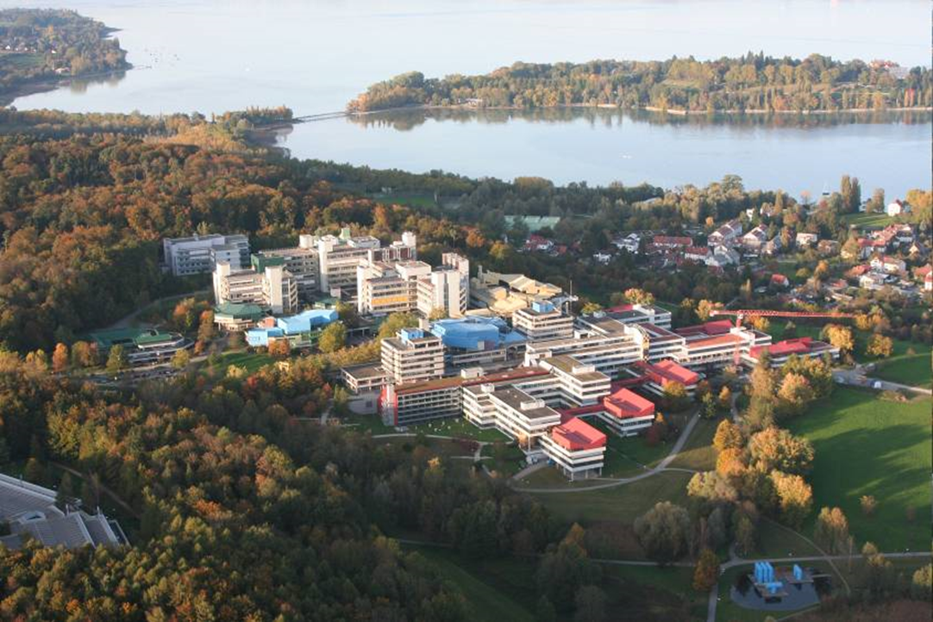
MA Politics/ Public Administration
Information Session about
the second year of studies
Werner Palz
Konstanz, 28th July 2022

Slide 2
Content
Second year abroad
MA thesis: supervisors
Transfer grades: courses and thesis
Questions and answers

Slide 3
1. Second year of MA-Studies at Partner Institution

Slide 4
General Information
You have to stay enrolled until the day on which you submit your MA thesis
It is not necessary to stay enrolled after that date
You will receive your MA degree certificate approx. 6 weeks after you hand in all relevant documents at the department
After the submission of your thesis, you can stay enrolled during the following semester, e.g. if this is a condition for an internship
The university will de-register you on the last day of that semester during which you will receive your MA degree certificate

Slide 5
General Information
To find information about the course selection at the partner institution:
http://www.polver.uni-konstanz.de/en/study-programmes/master-programmes/
→ Select Name of Partner Institution → Click on „Study Plan“
Also check the website of our partners.
In addition, our colleagues will provide with all necessary information during the process of enrolment.

Slide 6
MA-Thesis written abroad: Overview
You will write your dissertation at the partner university.
The thesis forms part of the credits that need to be obtained abroad.
Thus, you will have to follow only the administrative processes at our partner university.

Slide 7
MA-Thesis written abroad: Supervisors
It is important for us to maintain the quality standards
For that reasons, one of the two supervisors of the dissertation has to be a full-professor from Konstanz (c.f. slide number 6).
We recommend you to learn to know potential supervisors from Konstanz already during this semester and – towards the end of the semester – contact them and check their availability.
The partner university will inform the supervisors about their exact duties.

Slide 8
MA-Thesis written abroad: Formalities
At the end of year 2, after having submitted the final dissertation, you will have to hand in a form here in Konstanz, requesting the recognition of the study year, including the MA dissertation. Everything can be handed in by e-mail/PDF.
You need to present:
A PDF-copy of your dissertation
The official plagiarism form
A copy of the final transcript of grades of the partner institution
The recognition form
Please hand in the forms as soon as possible.

Slide 9
Questions and Answers

Slide 10
Thank you for your attention!
Werner Palz
Coordinator MA Programmes
Department of Politics and Public Administration
Tel.: +49 (0) 75 31/88 - 4274
master.polver@uni-konstanz.de

