Slide 1
International Relations Office
Erasmus Section
Ewa Makal-O’Hara

Slide 2
OLA 3.0
Online Learning Agreement
Strategic Partnerships Project
Digital LAs for studies and traineeships
Digital Transcript of Records
Recognition of academic achievements
Updated LA template for the new Erasmus Programme (2021-2027)

Slide 3
OLA 3.0
European University Foundation (Luxembourg)
Aristotle University of Thessaloniki (Greece)
Erasmus Student Network (Belgium)
University of Warsaw (Poland)
Erasmus University of Rotterdam (The Netherlands)
University of Alcala (Spain)
University of Bergen (Norway)
University of Luxembourg (Luxembourg)
University of Marburg (Germany)
University of Vienna (Austria)
University Paris 1 Panthéon-Sorbonne (France)

Slide 4
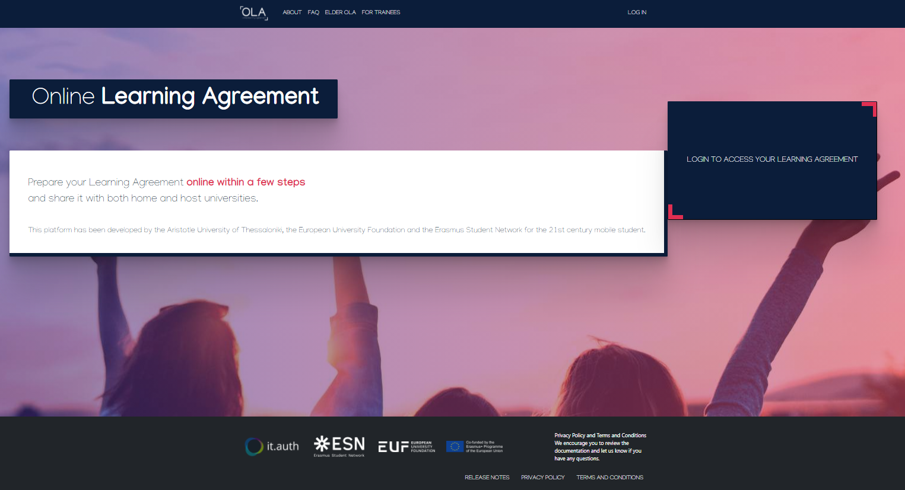
OLA for students

Slide 5
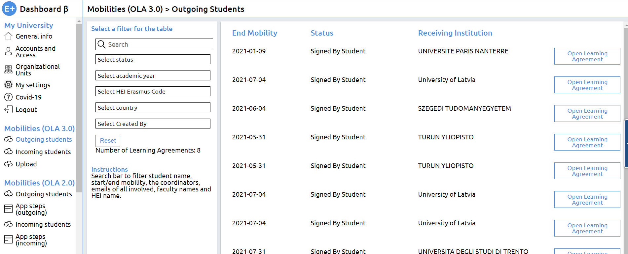
OLA for university staff

Slide 6
A solution for universities with their own mobility software
EWP - a network (not another system) for data exchange
Transfer of data to/from your OWN university system
EWP connectors – free software available to IT teams
Signing students’ LAs in your OWN university system
External systems
Logging in required
Best solution for universities with no mobility software

Slide 7
EWP Network - digital management of:
Learning Agreements (studies & traineeships)
Transcript of Records
Student nominations
Interinstitutional Agreements
...

Slide 8
Thank you!
ewa.makal@adm.uw.edu.pl

